Slide 1
Classification Models
Accessed three classification models for accuracy comparison
Logistic Regression
MultinomialNB
Random Forest Classifier

Slide 2
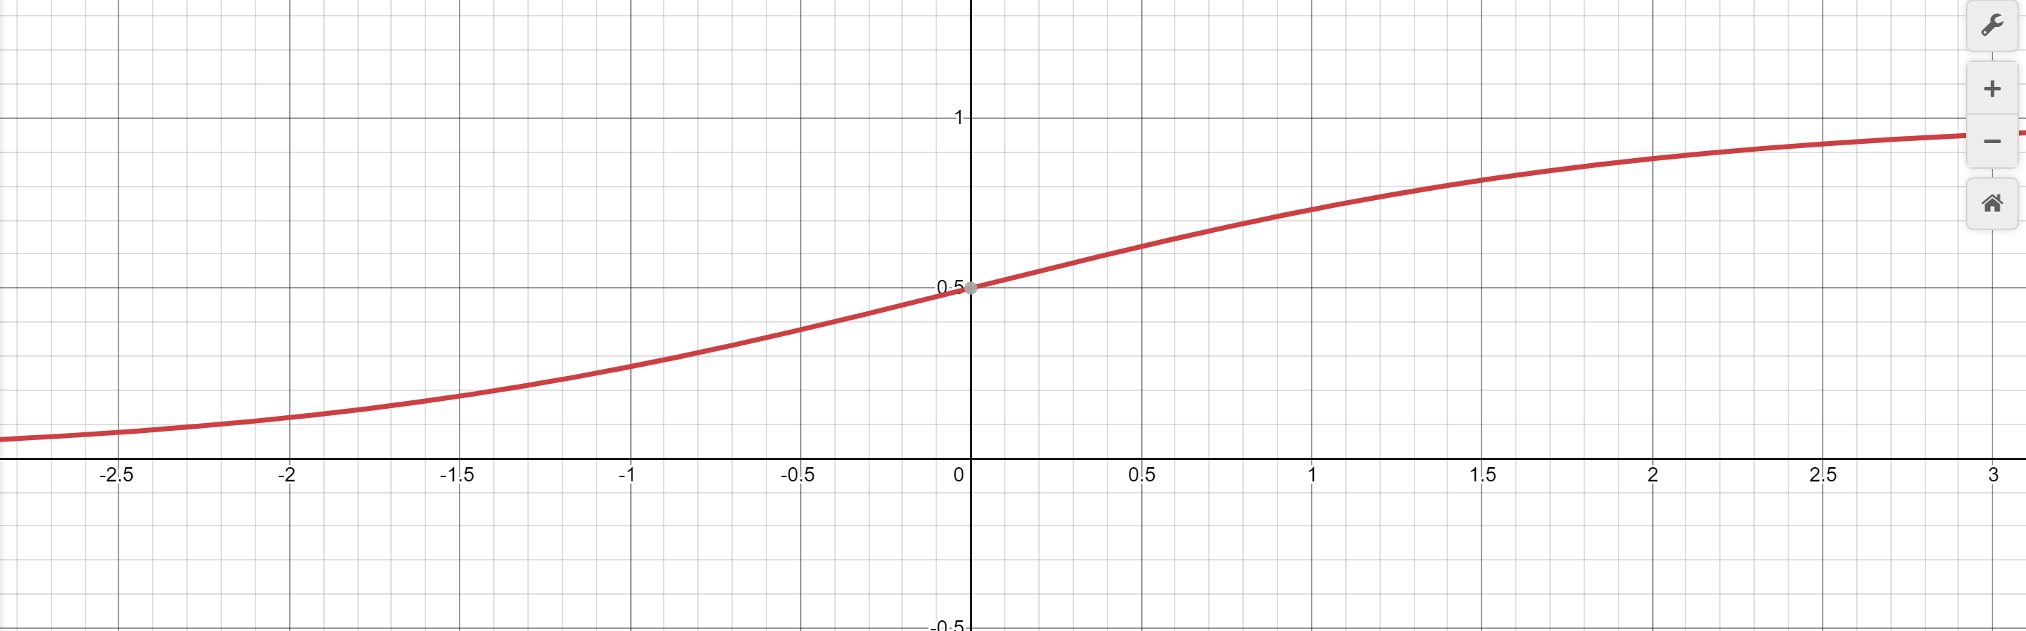
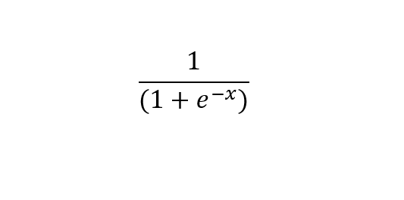
Logistic Regression
Is based on the sigmoid function
Returns 0 and 1

Slide 3


LogisticRegression Model
Model Equation
Pr(Y_{ik}), is the probability that a given observation, i , will belong to a category, k, of mth categories and $β_{k}$being the row vector of regression coefficients of X.
Notes:
In reagrad to our dataset the following equation is applied

Slide 4
Logistic Regression Model
Advantages
It is efficient and does not require many computational resources.
Highly interpretable
Easy to regularize
Disadvantages
Should not be used if the number of observations are less than the number of features. This can lead to overfitting.
It should only be used to predict discrete functions.

Slide 5
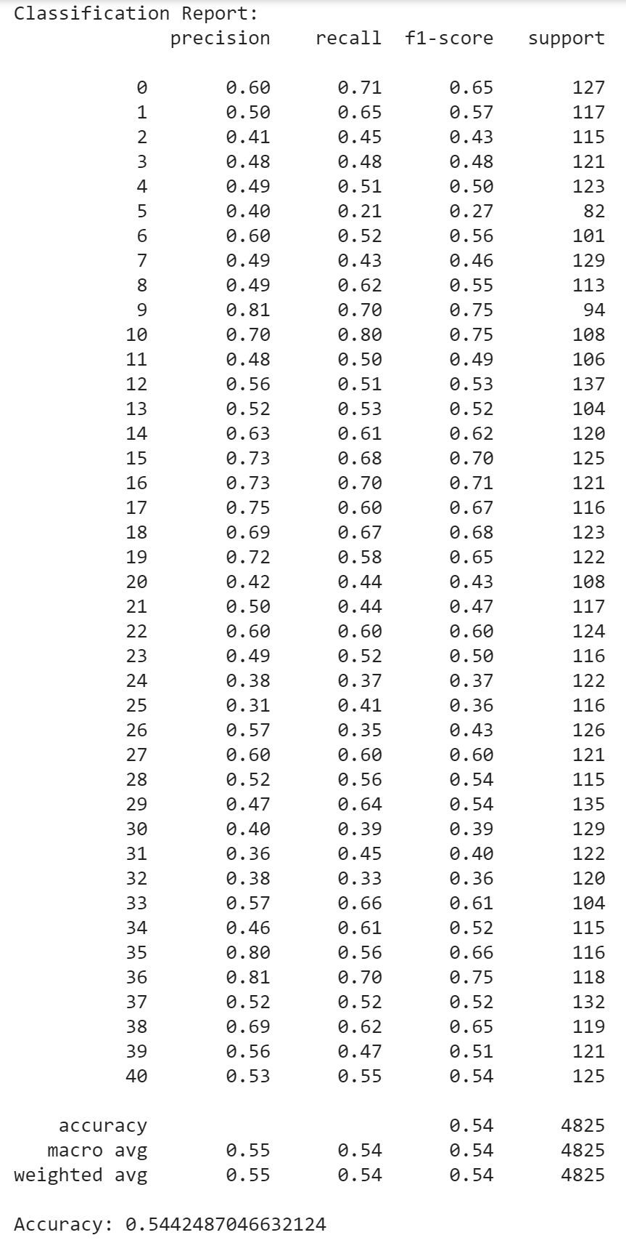
Logistic Regression Model
Results and Classification Report
Accuracy of the model: 0.5442

Slide 6
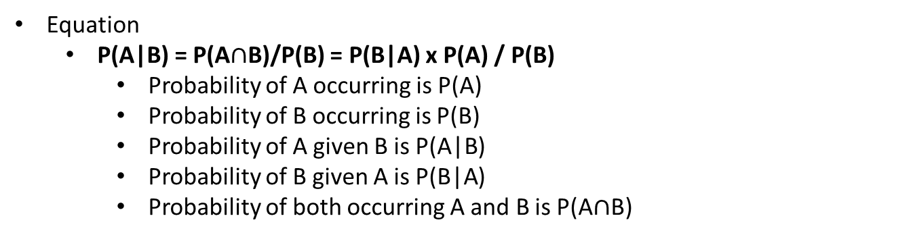
MultinomialNB Model
Based on Baye’s Theorem
Is used to determine the probability of an event occurring, given that the probability of another event has already happened.
Equation
P(A|B) = P(A$∩$B)/P(B) = P(B|A) x P(A) / P(B)
Probability of A occurring is P(A)
Probability of B occurring is P(B)
Probability of A given B is P(A|B)
Probability of B given A is P(B|A)
Probability of both occurring A and B is P(A$∩$B)
Notes:
In reagrad to our dataset MultinoalNM model is applied and the equation is following

Slide 7
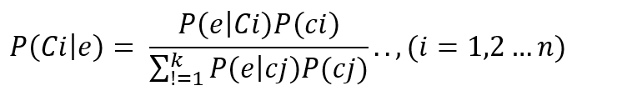
MultinomialNB Model
Model Equation
Ci is the previous probability class
The posterior probability P (Ci|e) is obtained from the Bayesian formula.

Slide 8
MultinomialNB Model
Advantages
It is simple and fast. Also, has low computation cost.
Performs well with small datasets.
Can be used for multiple class perdition scenarios.
Requires less training data.
Best suited for text classification.
Disadvantages
Chances of loss accuracy.
Zero frequency, if the category variable is not seen in training data. The model assigns a zero probability, leading to prediction not being made.

Slide 9
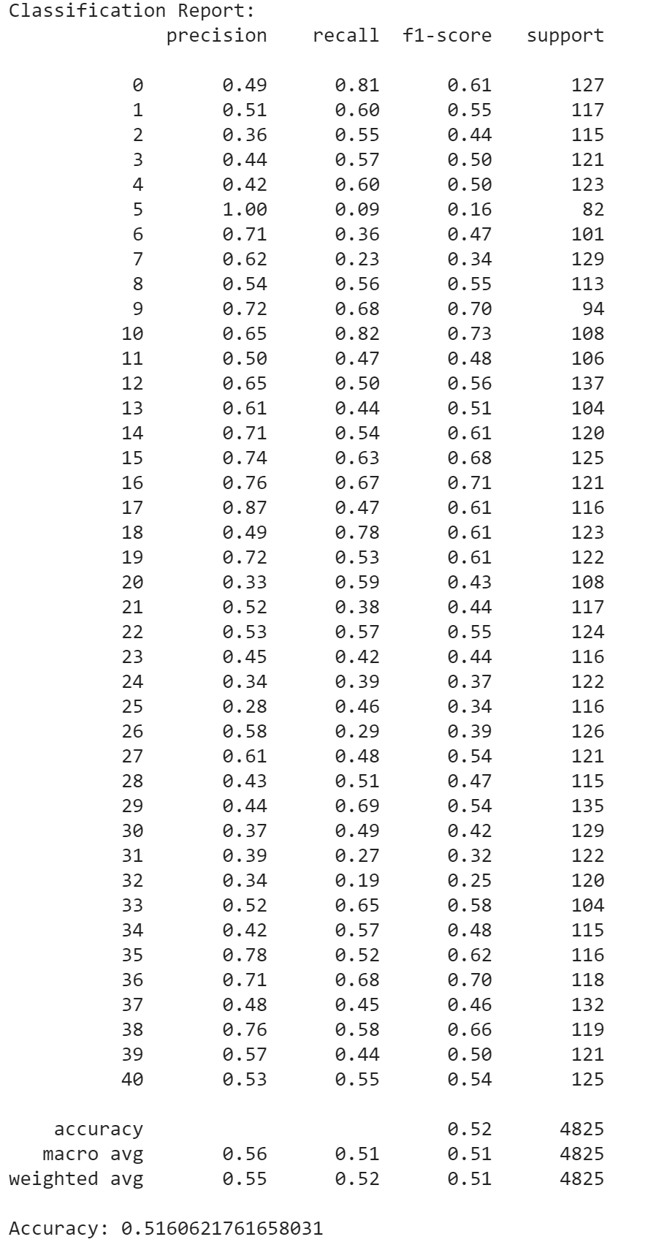
MultinomialNB Model
Results and Classification Report
Accuracy of the model: 0.5161

Slide 10

Random Forest Classifier Model
The model is made up of hundreds or thousands decision trees.
The model uses to concepts:
Random sampling of training data points when building trees,
Random subsets of features considered when splitting nodes.
The Random Forest Classifier is expressed in the following formula:
where -p and -q is the proportion of negative samples, and p+ and q+ is the proportion of positive samples. Entropy of one means the class labels are equally divided, and zero means the sample is completely homogenous.
Advantage
Able to handle non-linear numeric and categorical predictors and outcomes. Where others require numeric inputs and assume linearity. So, it is good for both classification and regression.
Disadvantage
Requires much more computational resources.
Can be difficult to determine significance of each variable

Slide 11
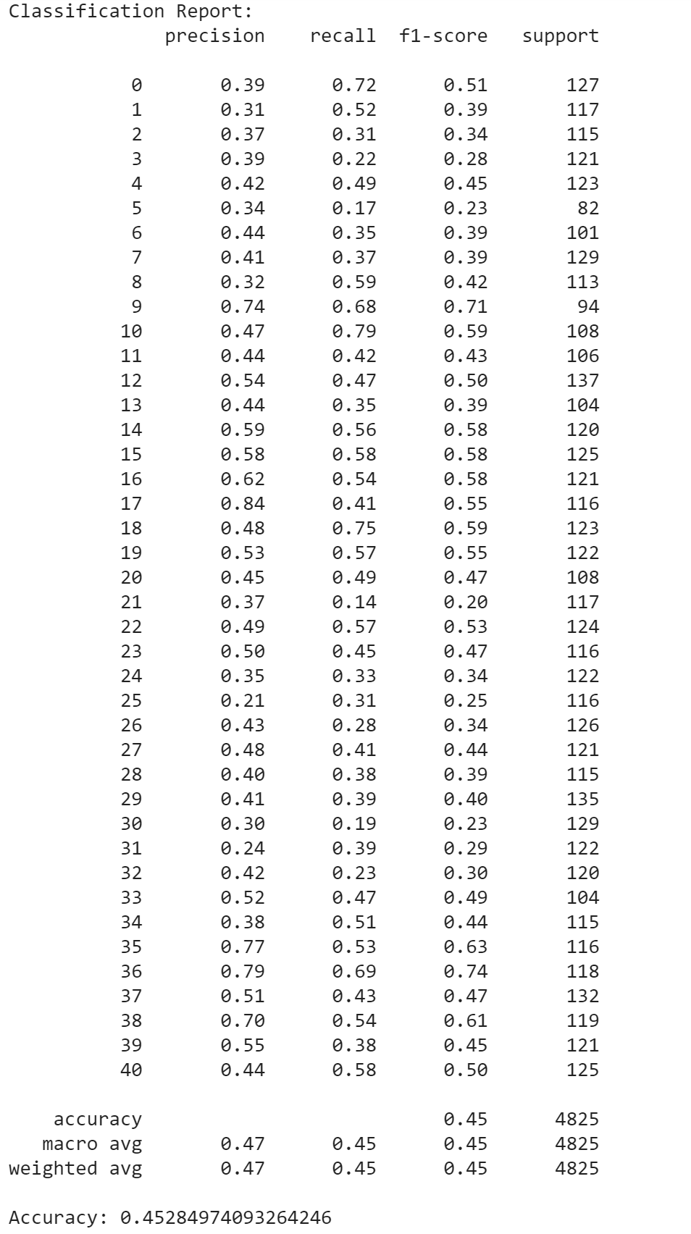
Random Forest Classifier Model
Classification Report and Results
Accuracy of the model: 0.4528

Slide 12
Reference
https://www.investopedia.com/terms/b/bayes-theorem.asp#:~:text=Bayes'%20theorem%2C%20named%20after%2018th,formula%20for%20determining%20conditional%20probability.&text=Bayes'%20theorem%20provides%20a%20way,given%20new%20or%20additional%20evidence.
https://www.geeksforgeeks.org/naive-bayes-classifiers/
https://www.datacamp.com/community/tutorials/naive-bayes-scikit-learn
https://www.educba.com/naive-bayes-algorithm/
https://towardsdatascience.com/an-implementation-and-explanation-of-the-random-forest-in-python-77bf308a9b76
https://www.mygreatlearning.com/blog/random-forest-algorithm/

